Slide 1
2012 SIAIS PERFORMS

Slide 2
National council members 2012-2014
President - Pedrini Daniela
National Members
Bono Giuseppe A.
Borelli Gianluca
Canini Antonio
De Marco Amedeo
Ganassi Agger Simona
Pensalfini Francesco
Rombini Fabio
Rossolini Sergio
Sabbatini Marco
Scarpini Gian Carlo
Treasurer
Conti Angelo
Vice President
Bucci Raffaela
Lenzi Alessandro
Verdoliva Ciro
Scientific segretary
Caviglia Alessandro
Quality
Mastroianni Lucina
IFHE Delegate
Marcello Fiorenza

Slide 3
auditors accounts
Paolo Scotto – President
Sergio Nucibella
Marchese Marcello

Slide 4
Coordinators of Regional SIAIS group
Novelli Massimo – “S.I.A.I.S. – Toscana”
Amedeo De Marco – “S.I.A.I.S. – Calabria”
Caria Giammario – “S.I.A.I.S. – Sardegna”
Paradiso Michele – “S.I.A.I.S. – Puglia”
Carlesi Giorgio – “S.I.A.I.S. – Lazio”
Sabatini Enrico – “S.I.A.I.S. – Emilia Romagna”
Corradini Heinrich – “S.I.A.I.S. – Trentino Alto Adige”
De Leo Giulia - “S.I.A.I.S. – Umbria”
Pellegrini Gianluca - “S.I.A.I.S. – Marche”
Muccio Palma Domenico - “S.I.A.I.S. – Liguria”
Ferri Claudio - “S.I.A.I.S. – Lombardia”
Corrente Giuseppe – “S.I.A.I.S. – Campania”
Gambuzza Carmelo – “S.I.A.I.S. – Sicilia”
Giuseppe Spera – “S.I.A.I.S. – Basilicata”
Tommaso Caputo – “S.I.A.I.S. – Veneto”
Filippo Manci – “S.I.A.I.S. – Abruzzo”

Slide 5


*
*
*
*

Slide 6
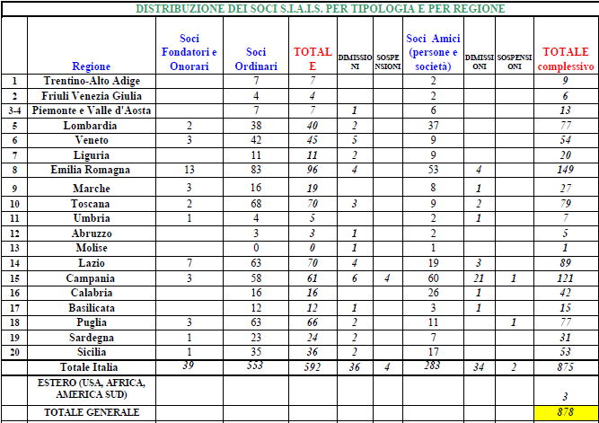

Slide 7



Financial Statements 2012
Ok!!!

Slide 8













S.I.A.I.S. – onorary members ONORARIO DI ANMDO DA MAGGIO 2010

Slide 9

International Partnership
EuHPN
IFHE – member 44-A
IFHE- EU

Slide 10
ACTIVITIES 'TRAINING: MOMENTS TO BRING QUALIFIED TRAINING AND PROFESSIONAL EXPERIENCE BASED "Esperience BASED KNOWLEDGE".
The S.I.A.I.S. already in progress of a project for training courses specifically tailored to the health care technicians (SCHOOL SIAIS), also in collaboration with other Associations and Institutions

Slide 11
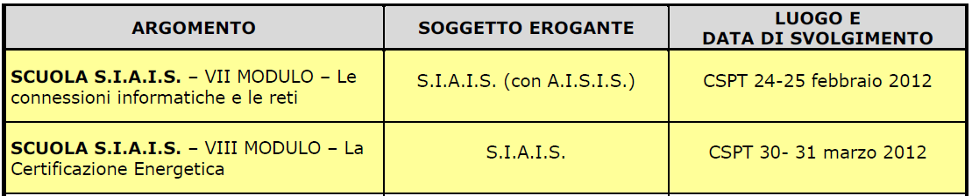

Slide 12
School training evaluation
I MODULO
II MODULO
III MODULO
IV MODULO
V MODULO

Slide 13
CONFRONTI - DOCENTI
I MODULO
II MODULO
III MODULO
IV MODULO
V MODULO

Slide 14
2012 activity: seminars, congress, trainings

Slide 15
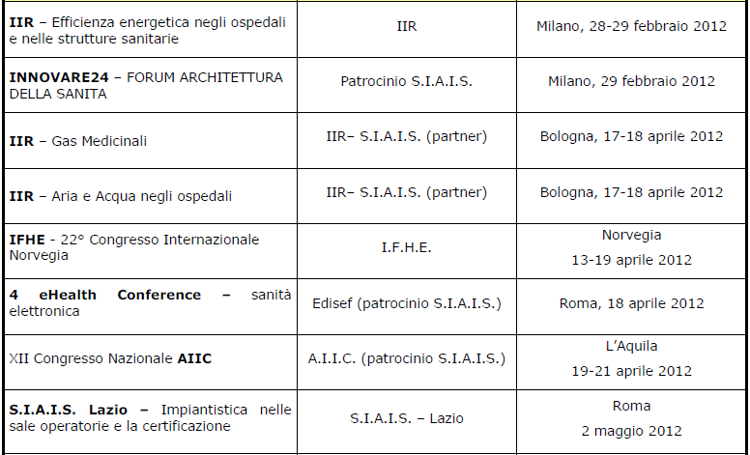

Slide 16
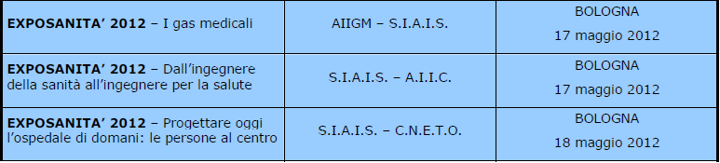
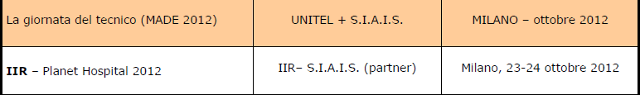

Slide 17

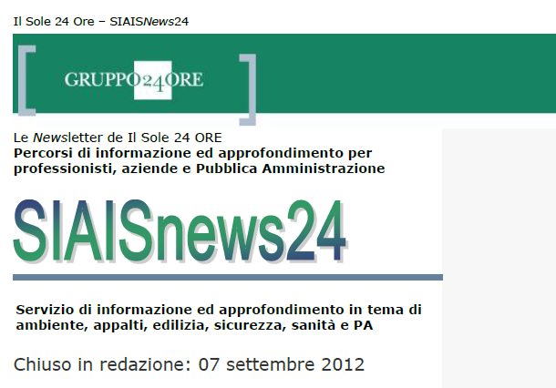
SIAIS NEWS

Slide 18
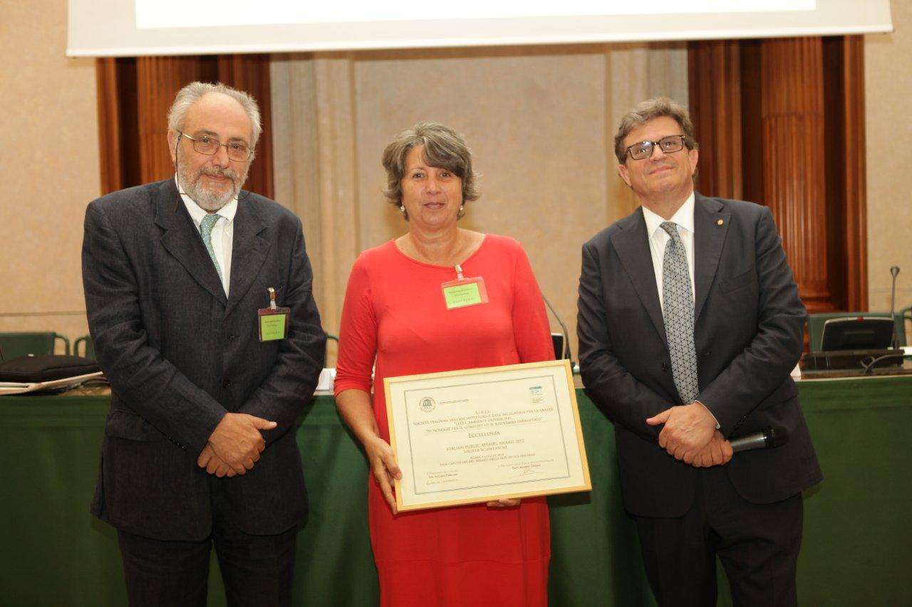
S.I.A.I.S. is awarded the Public Affairs Awards 2012 for the project
"Led and hospital environments. Technologies for comfort and energy savings

Slide 19

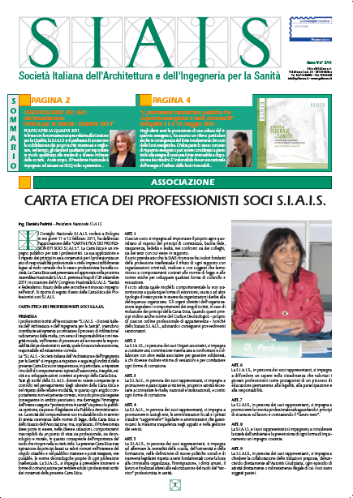



Slide 20

SIAIS cooperation

Slide 21

RES-Hospital
Renewable Energy Sources-Hospital
The project that has as its acronym Hospitals-RES (Renewable energy-Hospitals) aims to reduce emissions of carbon dioxide CO2 in approximately 15,000 hospitals in Europe.
The aim is to create a dialogue of comparison among the countries participating in the initiative, in order to explore the obstacles 'non-technical' which prevent the exploitation of energy efficiency measures and the use of renewable energy systems.
Study of the possibility of applying energy saving measures to achieve the objectives of long-term CO2 reduction through the use of renewable energy.
Identification of tools that help the health care system to have greater clarity on the need for sustainability and knowledge of improvements to be able to take appropriate decisions in a short time.

Slide 22





Table of comparison between Energy Mangers and Managers technicians working in the hospital sector with the participation of public and private entities of four different European countries and a research organization based in the Netherlands.
Project led by the Local Health of Asti (ASL) - AT
Project’s Partners
Optimat Ltd (UK)
BIOEF (ES)
ECHAA
SIAIS (Italy)
TNO (Netherlands)

Slide 23
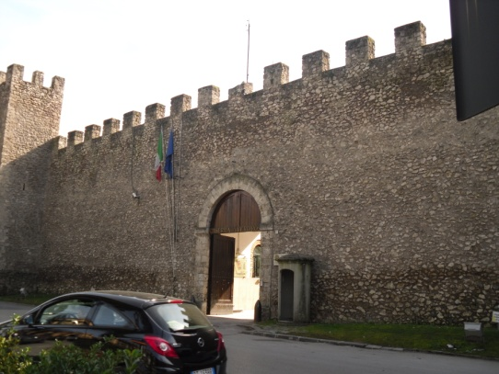
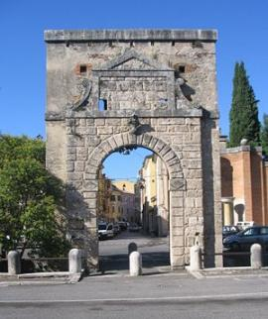

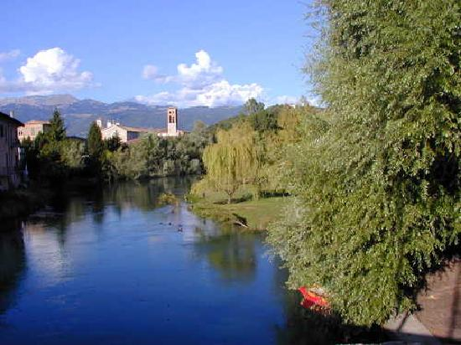
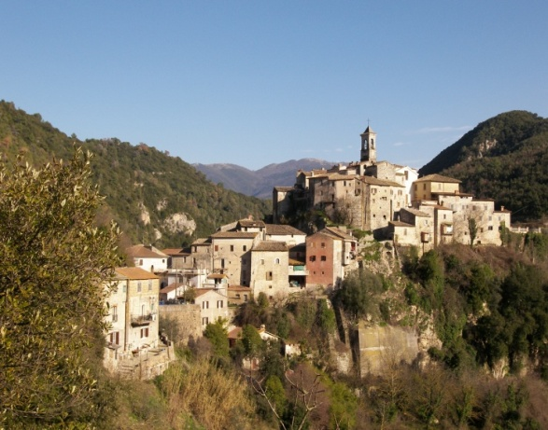

VIII NATIONAL CONGRESS «TECNOLOGY AND HEALTH» RIETI OCTOBER 2012

Slide 24
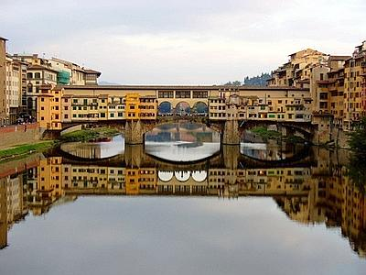
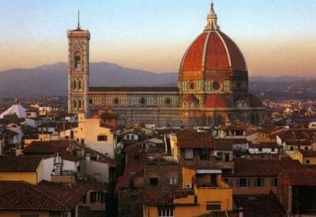
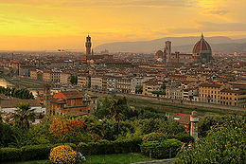
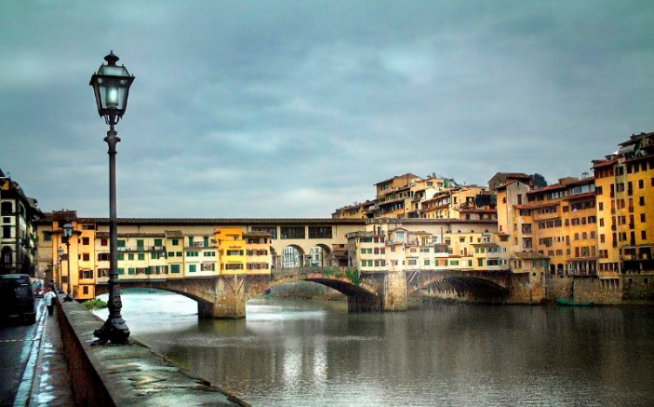
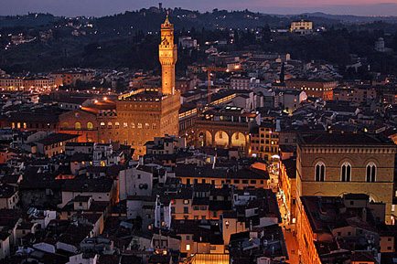
V° CONGRESSO NAZIONALE SIAIS
FIRENZE 2013

Slide 25
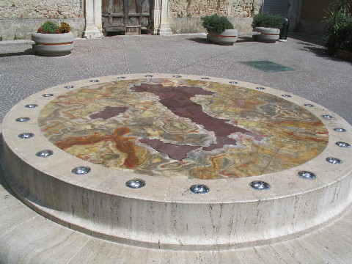
25TH CONGRESS OF IFHE
CENTRE OF ITALY
CENTRE OF ITALY
2018 MAY 7-8-9

Slide 28

SEE YOU IN ARGENTINA

